Slide 3
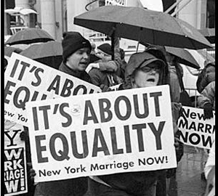

Slide 6
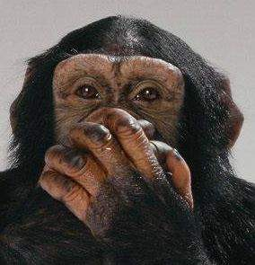
Speak No Evil

Slide 8
That’s So…

Slide 10
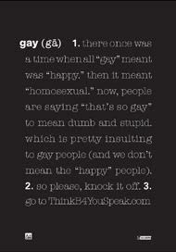

Slide 12
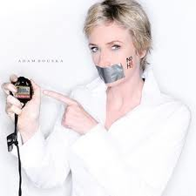

Slide 20
“They say that time changes things,
but you actually have to change them
yourself.”

